Slide 1
Lecture 15

Slide 2
Question

Slide 3
E

Slide 4
E

Slide 5
Question
What do we call a light wave that has an E-filed that oscillates in just one direction?
Confined
Polarized
Linear
Confocal
E

Slide 6
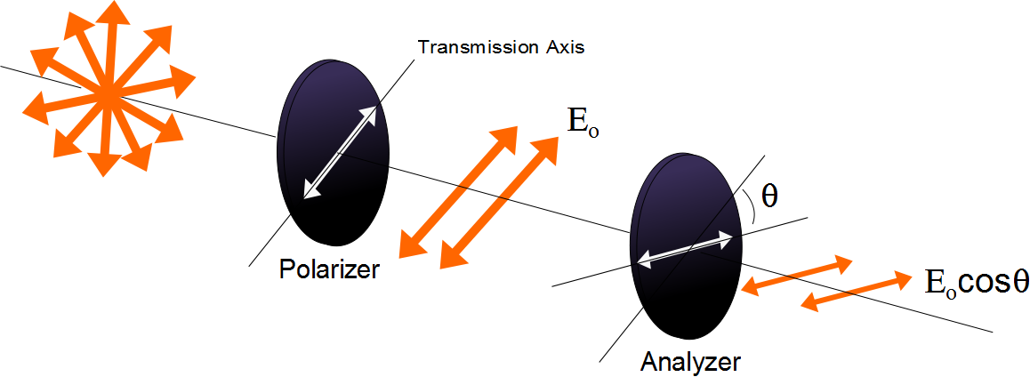

Slide 7
Question
I have two polarizers. If I pass light through both of them and their axes are aligned at 90 degrees from each other how much of the original light comes through?
All of it
30%
70%
None of it

Slide 8
E
Incident Beam
Reflected Beam
θ₁
θ₁
n₁
n₂
Transmitted Beam
θ₂

Slide 9
Electron disturbance in SHM

Slide 10
+++
--
~
~
~
~
---
++
A B C D

Slide 12
E
Reflected Beam
Has only the
perpendicular
polarization
Incident Beam
θ_{b}
θ_{b}
n₁
90°
n₂
Transmitted Beam
θ₂

Slide 13
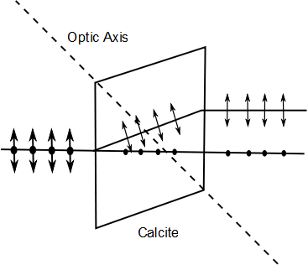
E-ray
Unpolarized Light
O-ray

Slide 14
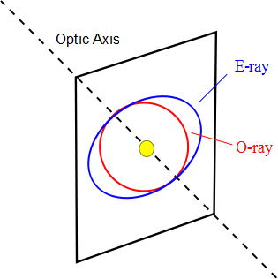

Slide 15
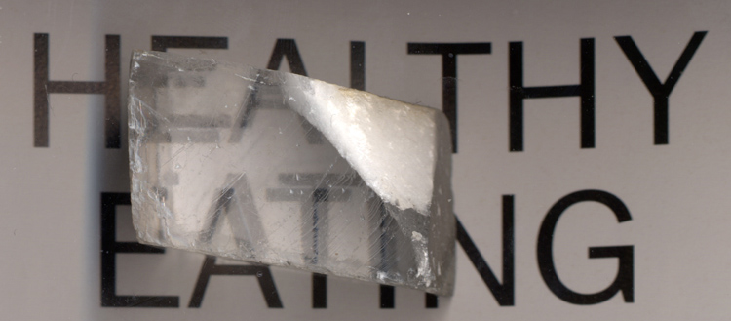

Slide 16
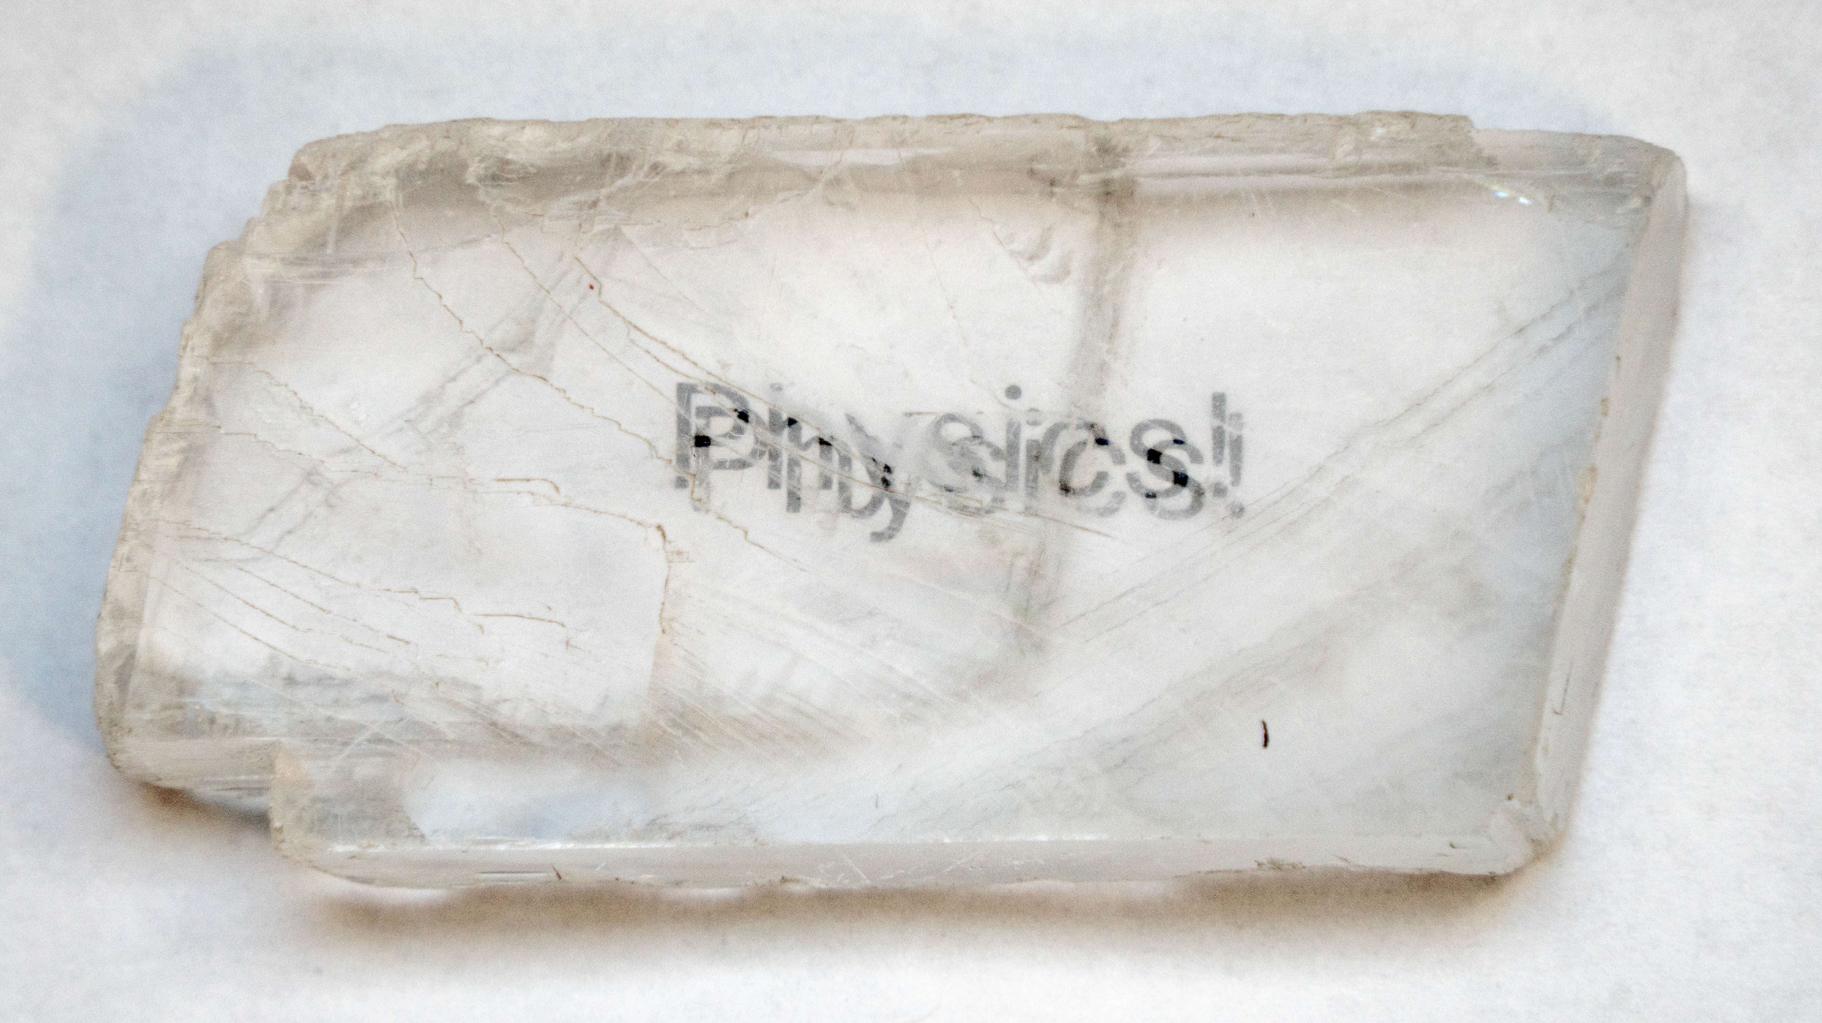

Slide 17
Polarization by Double Refraction, Rays
The ordinary (O) ray is characterized by an index of refraction of n_{o}
This is the same in all directions
The second ray is the extraordinary (E) ray which travels at different speeds in different directions
Characterized by an index of refraction of n_{E} that varies with the direction of propagation

Slide 18

Optical Stress Analysis

Slide 19
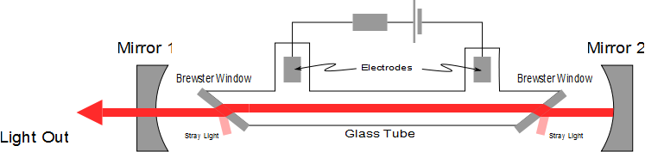
Laser Polarization

Slide 20
d_{o}
d_{i}

Slide 23
Question 223.16.7
Diving masks often have a lens built into the glass for divers who do not have perfect vision. This allows the individual to dive without the necessity for glasses, because the lenses in the faceplate perform the necessary refraction to provide clear vision. The proper design allows the diver to see clearly with the mask on both under water and in the open air. Normal eyeglasses have lenses that are curved on both the front and rear surfaces. The lenses in a diving mask should be curved
only on the front surface
only on the rear surface
on both the front and rear surfaces

Slide 24
Question 223.16.8
Consider a flat mirror. Which of the following is true?
The image is as far behind the mirror as the object is in front
The image is twice as far away as the object is from the mirror
The image is farther away, but you would need to know the particular circumstances to know how far.
The image is in the same place as the object.

Slide 25
Question 223.16.9
What is the magnification of a flat mirror
1
2
-1
½
The image is unmagnified

Slide 26
Question 223.16.10
When you look in a flat mirror you observe
Left right reversal
Top bottom reversal
Front back reversal
No reversal

Slide 27
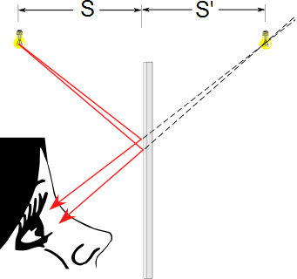
Flat Mirrors
Simplest possible mirror
Light rays leave the source and are reflected from the mirror
Point I is called the image of the object at point O
The image is virtual
O
d_{o}
I
d_{i}

Slide 28
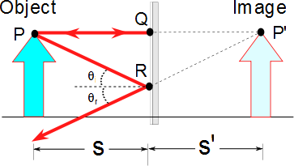
Flat Mirrors
One ray starts at point P, travels to Q and reflects back on itself
Another ray follows the path PR and reflects according to the law of reflection
d_{o}
d_{i}

Slide 29
Images Formed by Flat Mirrors, 4
To observe the image, the observer would trace back the two reflected rays to P’
Point P’ is the point where the rays appear to have originated
The image formed by an object placed in front of a flat mirror is as far behind the mirror as the object is in front of the mirror
|s| = |s’|

Slide 30
Lateral Magnification
Lateral magnification, M, is defined as
This is the general magnification for any type of mirror
It is also valid for images formed by lenses
Magnification does not always mean bigger, the size can either increase or decrease
M can be less than or greater than 1

Slide 31
Lateral Magnification of a Flat Mirror
The lateral magnification of a flat mirror is 1
This means that h’ = h for all images

Slide 32
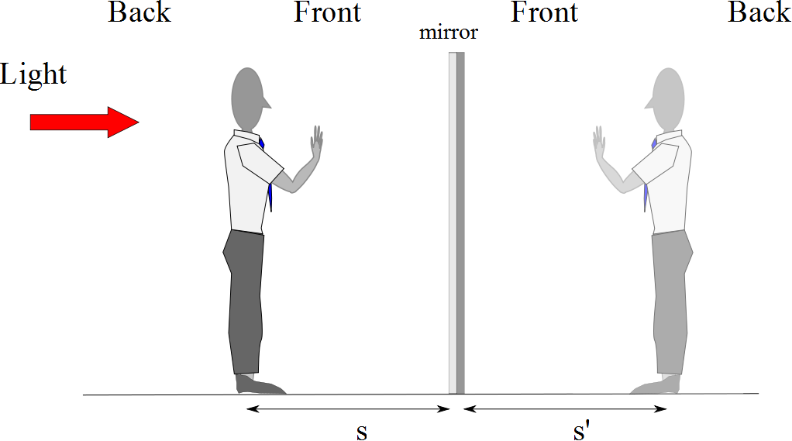
Reversals in a Flat Mirror
d_{o}
d_{i}

Slide 33
Reversals in a Flat Mirror
d_{o}
d_{i}

Slide 34
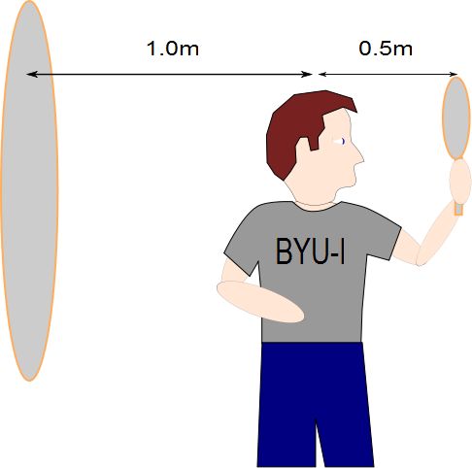
Question 223.13.11
The image of the man’s face in the small mirror will be half a meter away. How far away from the large mirror will the image of this image be?
Half a meter
A meter
1.5 meters
2 meters
What are you talking about?

Slide 35
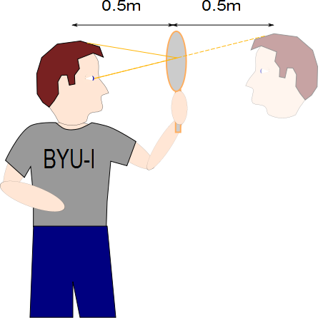

Slide 36
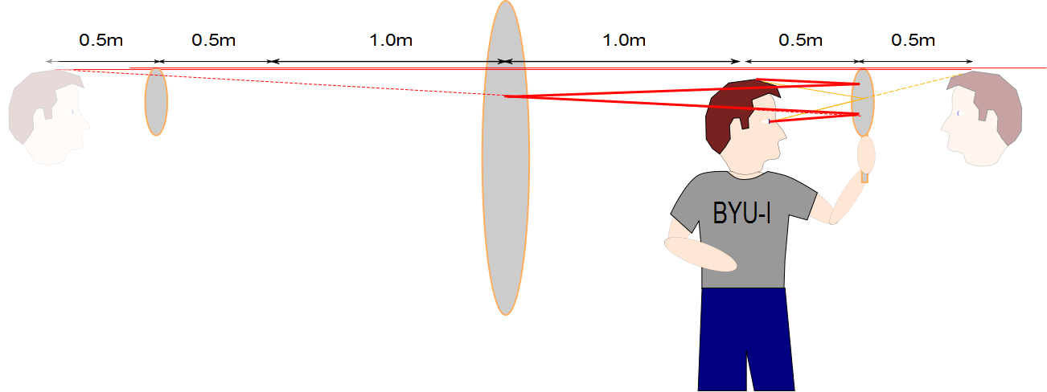

Slide 38
END

Slide 39
End

Slide 40
E

Slide 41
E

Slide 42
Question
What do we call a light wave that has an E-filed that oscillates in just one direction?
Confined
Polarized
Linear
Confocal
E

Slide 44
Question
I have two polarizers. If I pass light through both of them and their axes are aligned at 90 degrees from each other how much of the original light comes through?
All of it
30%
70%
None of it

Slide 47
E
Incident Beam
Reflected Beam
θ₁
θ₁
n₁
n₂
Transmitted Beam
θ₂

Slide 48
E
Reflected Beam
Has only the
perpendicular
polarization
Incident Beam
θ_{b}
θ_{b}
n₁
90°
n₂
Transmitted Beam
θ₂

Slide 50
E-ray
Unpolarized Light
O-ray

Slide 52
Polarization by Double Refraction, Rays
The ordinary (O) ray is characterized by an index of refraction of n_{o}
This is the same in all directions
The second ray is the extraordinary (E) ray which travels at different speeds in different directions
Characterized by an index of refraction of n_{E} that varies with the direction of propagation

Slide 53
Optical Stress Analysis

Slide 54
Laser Polarization

Slide 55
END

